Slide 1

Satellite Image Processing
By :
Ajay Varshney
Anubhav Yadav
Aayush Sharma

Slide 2
Abstract
Satellite image processing plays a vital role for research and developments in Astronomy, Remote Sensing, GIS, Agriculture Monitoring, Disaster Management and many other fields of study.
Satellite images are recorded in digital forms and then processed by the computers to extract information.

Slide 3
Field of invention..
This invention lies under the category of Machine learning.
It is a branch of artificial intelligence (AI) and computer science.
It focuses on the use of data and algorithms to imitate the way that humans learn, gradually improving its accuracy.

Slide 4
What's image processing ?
Digital image processing refers to the process of recognizing, making algorithmic enhancements and manipulating a digital image.
In general, the technology deals with images that are two-dimensional entities (like satellite pictures, scanned documents etc) captured electronically. In the process, multiple computer algorithms are used by developers to solve different tasks.

Slide 5
Objective
Takes a satellite image of a particular area.
Highlights the roads detected in that area.
Highlights the buildings detected in that area.
Highlights the vegetation in that area
Creating land-use/landcover map of an area
And some similar operations like those

Slide 6
Approach / Model…
These approaches and methods fall into five categories which are supervised classification, unsupervised classification, pixel-based classification, object-oriented classification, and Convolutional neural network classification or CNN classification.
2.There are a wide variety of models used for image classification. Popular choices of models for image classification tasks include YOLOv5, the Vision Transformer, and Resnet34.

Slide 7
Application
Providing a base map for reference.
Land-use/Landcover Mapping.
3D GIS and City Models.
Applications in Mining.
Planning for disaster mitigation
Applications in Agriculture and forestry
Monitoring Climate Change

Slide 8
DFD

Slide 9
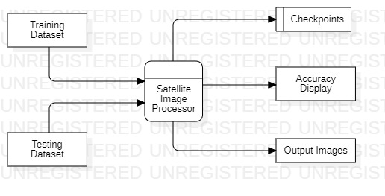
Level 0

Slide 10
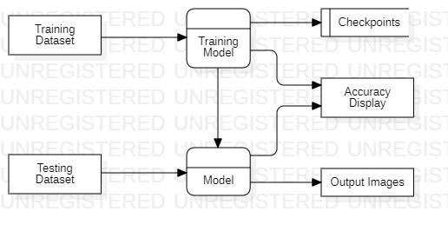
Level 1

Slide 11
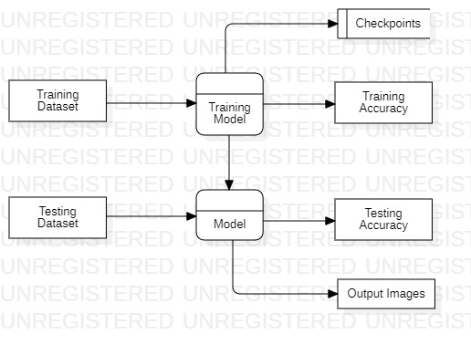
Level 2

Slide 12
ER-Diagram

Slide 13
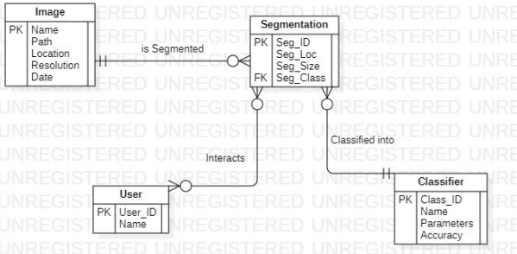
ER-Diagram

Slide 14
SRS

Slide 15
SRS

Slide 16

Thank You

